Slide 1


FIFTEEN PUZZLE
BY
Sneha Gavini
Naveen Kumar Vadlakonda

Slide 2
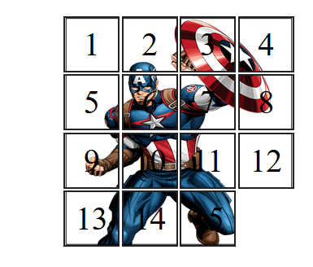
Problem
FIFTEEN PUZZLE

Slide 3

Technologies Used:
HTML
CSS
JAVASCRIPT
CSS ANIMATIONS

Slide 4

Home Page GUI

Slide 5
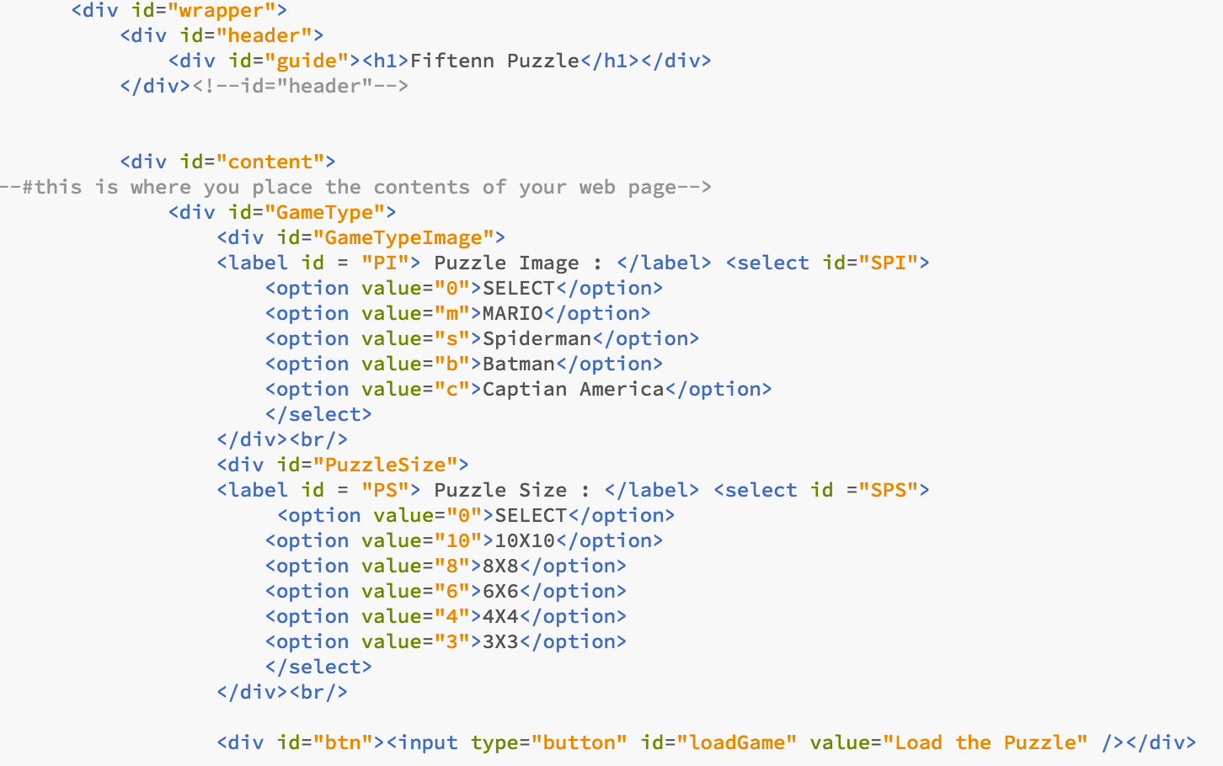
Home Page HTML

Slide 6
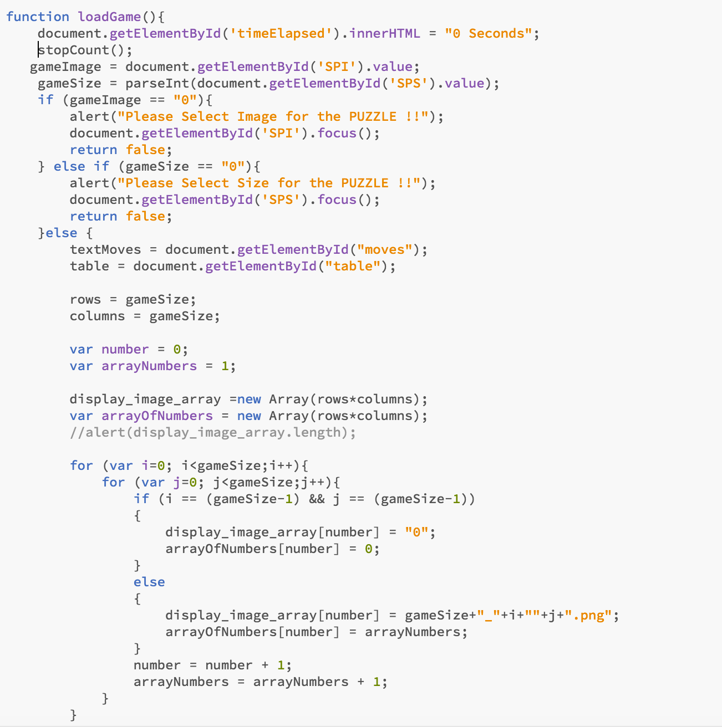
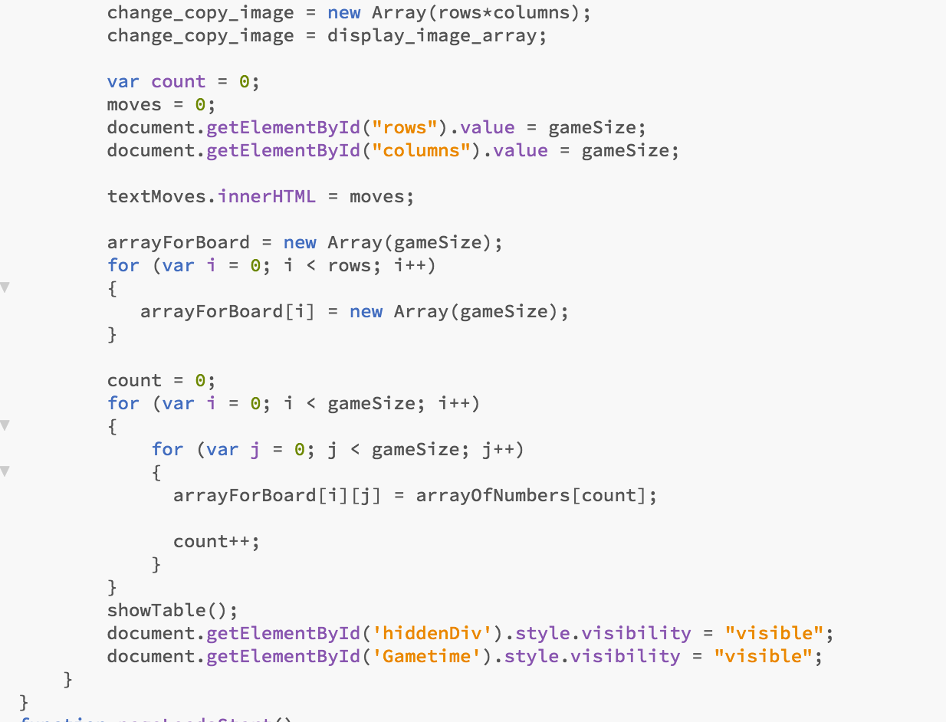
JavaScript code to load images and generate numbers

Slide 7
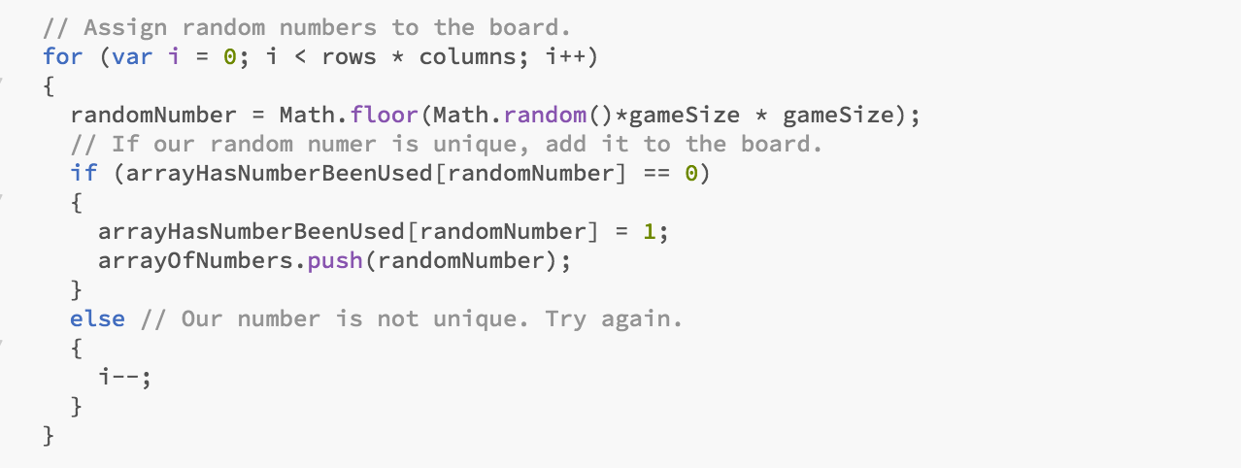
Assign random numbers to the game board

Slide 8
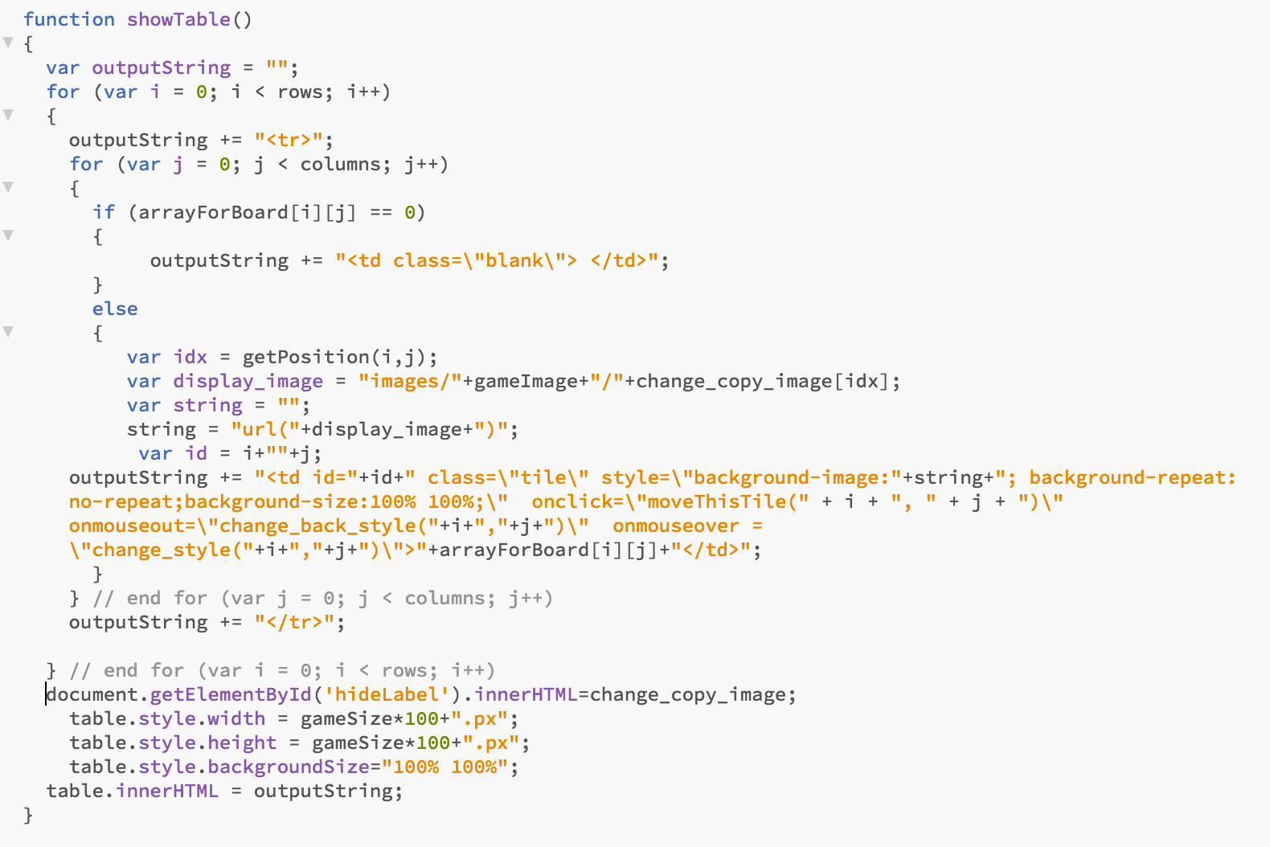
Display puzzle table

Slide 9

Have done CSS animation for the tile which will move and change the border and other style property.
CSS animation, I have done fading for infinite time until we move the tile.
Triggering that through the JavaScript.
MOVING TILES AND VERIFYING THE MOVABLE

Slide 10
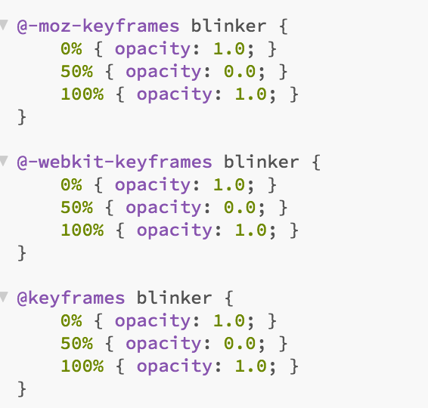
CSS Animation

Slide 11
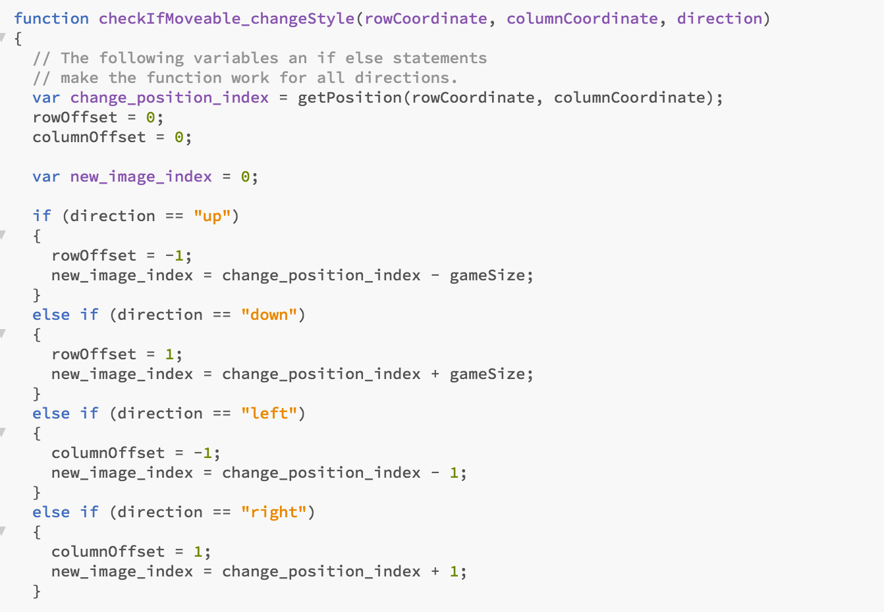
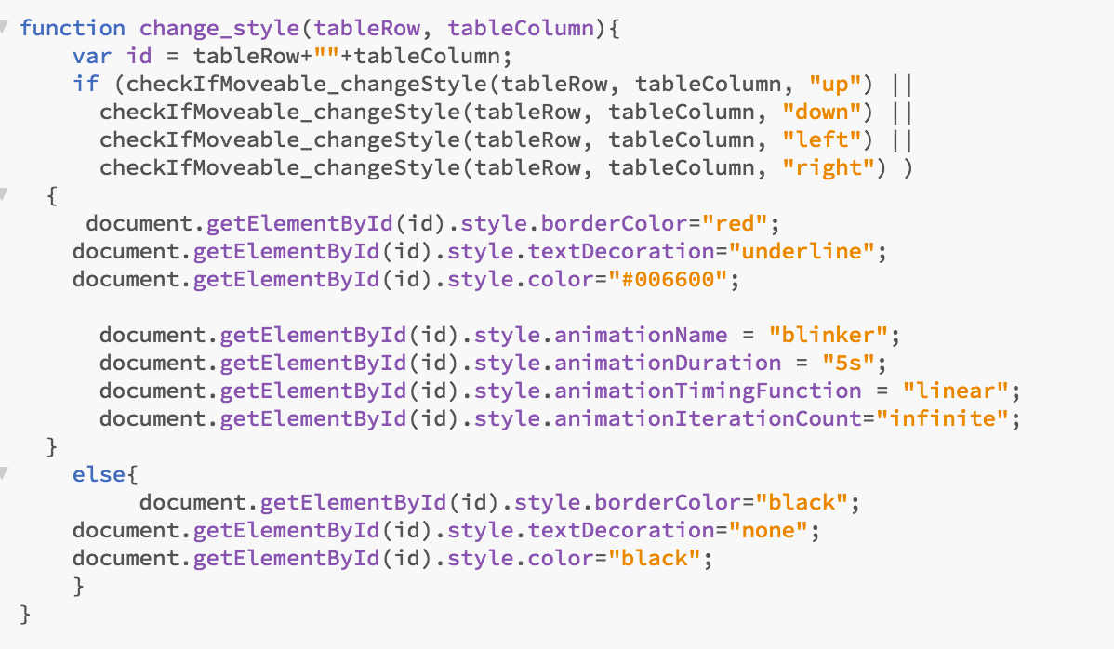
CODE FOR MOVING TILE AND CHANGING CSS

Slide 12
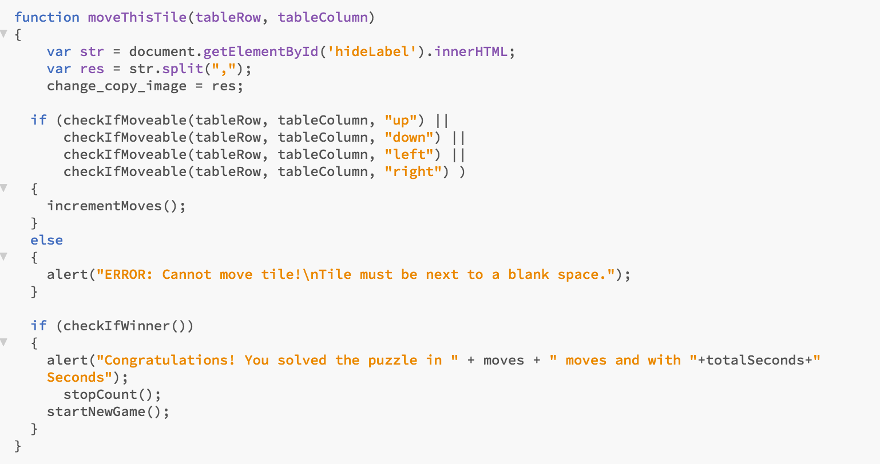

Slide 13
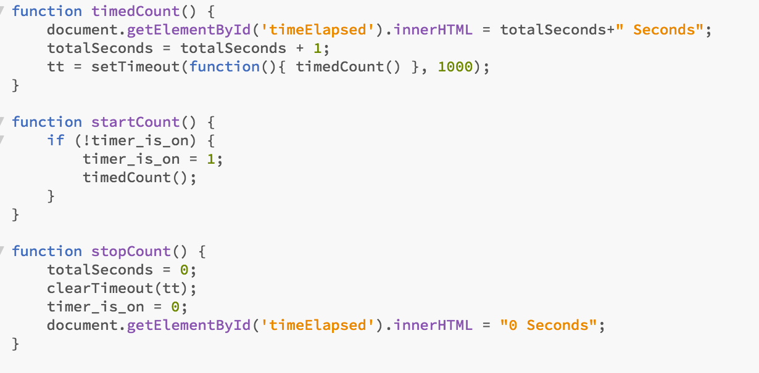
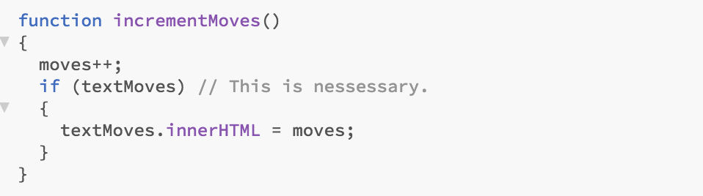
Functions to calculate time and no of moves

Slide 14
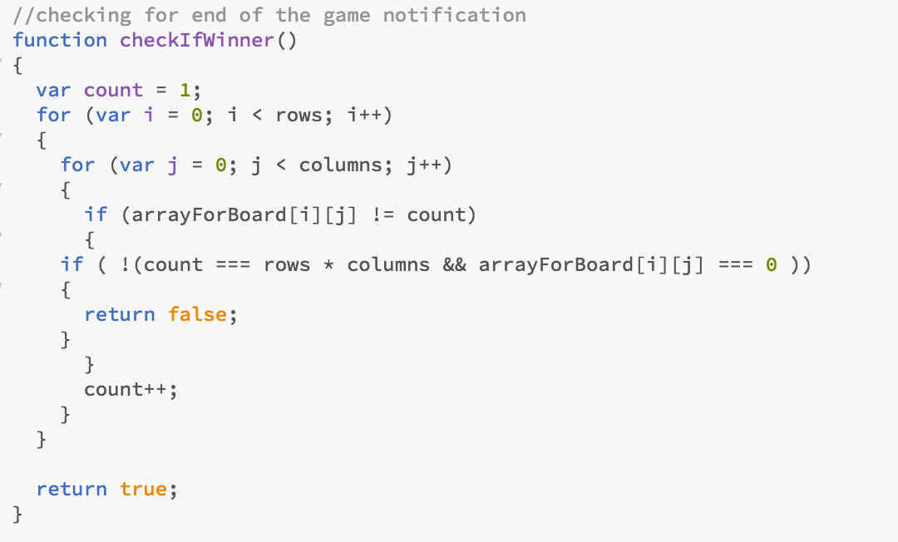
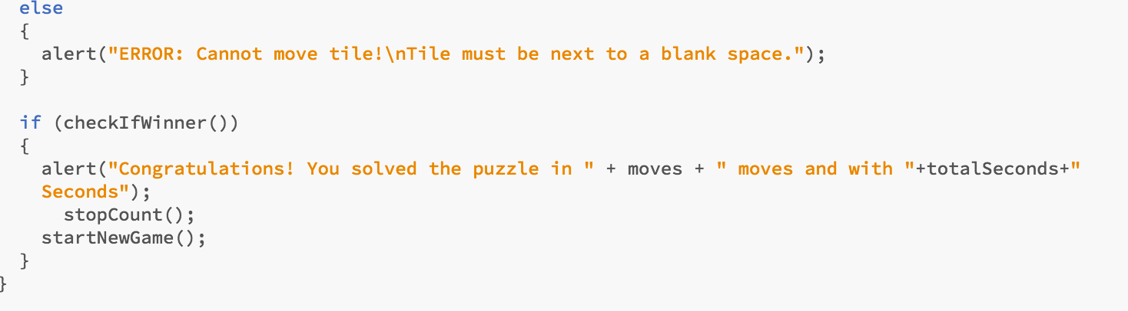
End Game Notification

Slide 15
Extra Features
Multiple Backgrounds
Different puzzle sizes
Animations and transistions
End of game notification

Slide 16

DEMO

Slide 17

THANK YOU

